Slide 1

A PRESENTATION ON
CAR RENTAL
SYSTEM
Prepared by: Subash Gurung, Rikita Gharti, Namrata Bastola, R.A.Mon Tiwari

Slide 2
In the ever-evolving landscape of transportation, the demand for flexible and convenient mobility solutions is at an all-time high. Car rental services play a pivotal role in meeting this demand by offering individuals and businesses the freedom to access vehicles as needed, without the commitment of ownership.
INTRODUCTION​

Slide 3
Today, we present a comprehensive solution: a sophisticated car rental system developed using Visual Basic .NET (VB.NET). This system encapsulates the essence of efficiency, convenience, and reliability, catering to the diverse needs of both customers and rental agencies.
INTRODUCTION​

Slide 4

PROBLEMS
Inefficient Manual Processes​
Economic Efficiency​
Poor Customer Experience
Complex Interface
Lack of Delivery Options
Limited Accessibility

Slide 5

OBJECTIVES
Easiness in Rental Processes​
Enhanced User Experience​
Real-time Availability Updates​
Secure Data Management​
Cost Efficiency

Slide 6

DEVELOPMENT
MS POWERPOINT:
For Presentation slides
ADOBE PHOTOSHOP:
For graphical logos
DISCORD:
For meetings
DRAW.IO:
For Flowchart,Dfd..
MS WORD:
For Gantt Chart
VISUAL STUDIO 2022:
For coding
MSQL:
For DATABASE

Slide 7
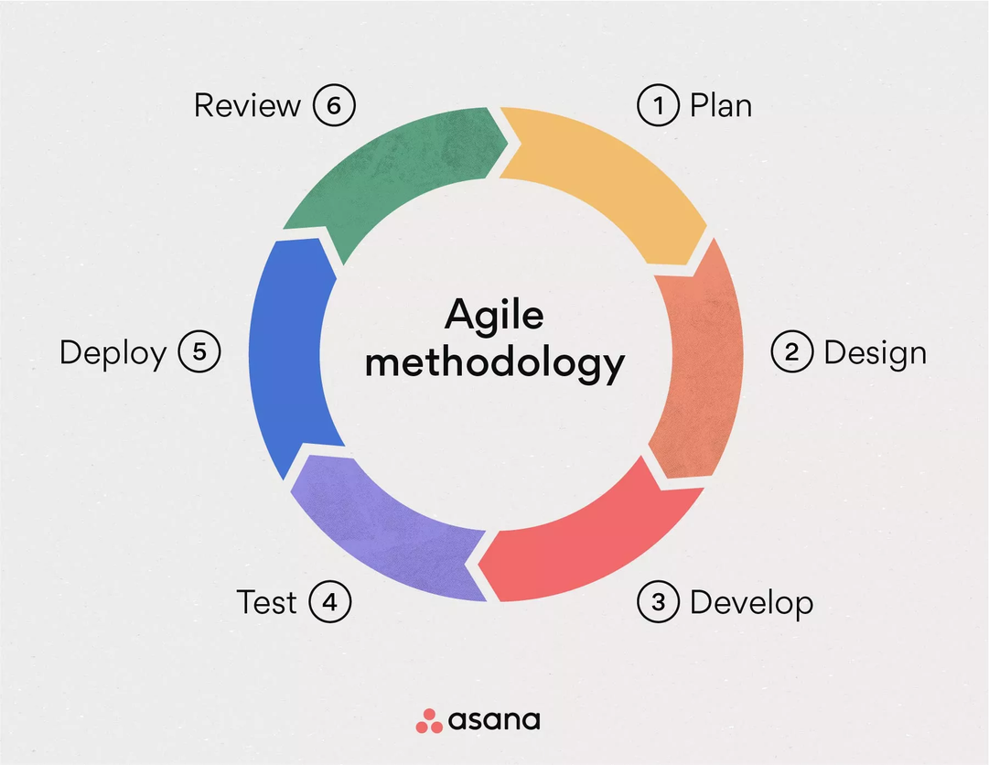
METHODOLOGY
Agile methodologies emphasize iterative development, collaboration, and flexibility in response to changing requirements.
Allows for frequent feedback loops, early delivery of working software, and close collaboration between the coder and documentation team.

Slide 8
METHODOLOGY
The coder can work in short development sprints (e.g., 1-2 weeks) to deliver specific features while the documentation team prepares and updates documentation based on evolving software features.
Use project management tools like Jira or Trello for sprint planning, task tracking, and collaboration.

Slide 9
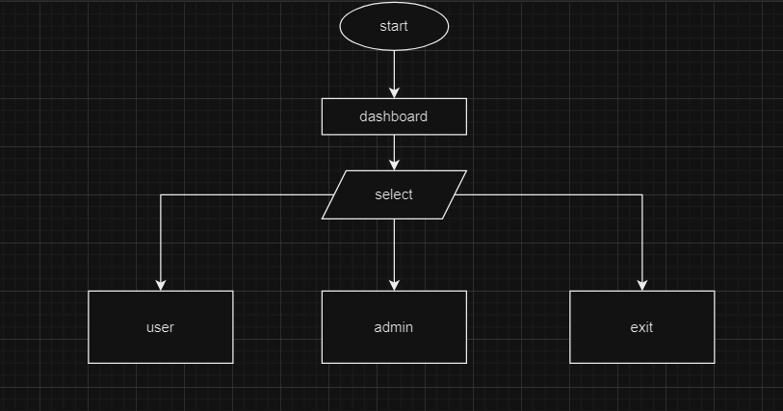
FLOWCHART I:
How does our system works?​
What features are we able to provide?​
What makes us different than others?

Slide 10
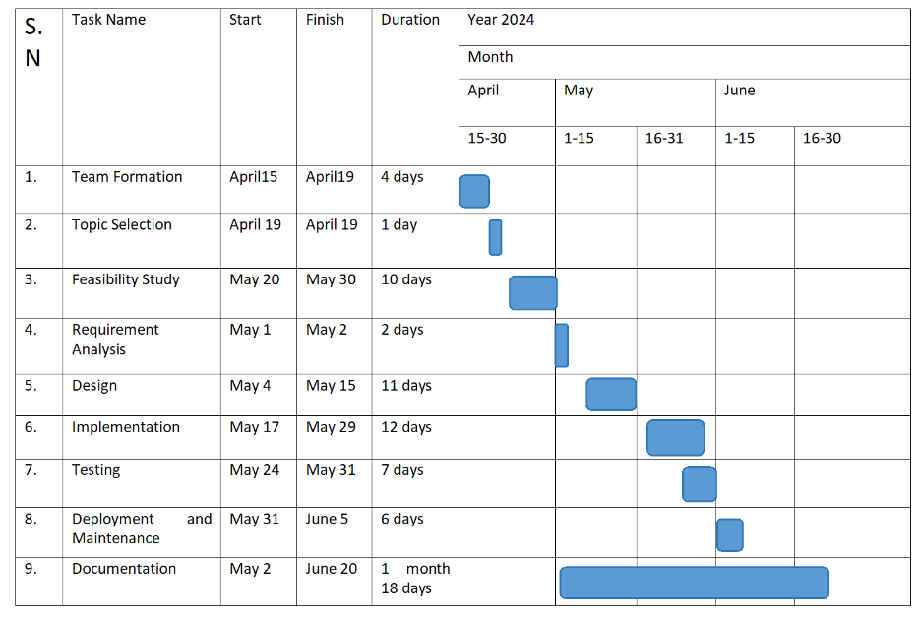
GANTT CHART:
How does our system works?​
What features are we able to provide?​
What makes us different than others?

Slide 11
PROJECT’S EXPECTED RESULTS​
How does our system works?​
What features are we able to provide?​
What makes us different than others?

Slide 12
THANKYOU
WE’RE OPEN FOR Q&A

